Slide 1
PROBLEMS SOLVED

Slide 2
Problem 1

Slide 3
Problem 2

Slide 4
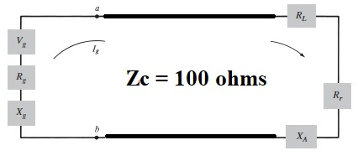
Problem 3

Slide 5
Problem 3 cont.

Slide 6
Problem 3 cont.

Slide 7
WORNING
At the exam will be either problems of the type in this slide, or problems like the ones in the course examples.
La examen se vor da fie probleme de tipul celor din acest slide , fie probleme de tipul celor din exemplele din curs.

